Slide 1
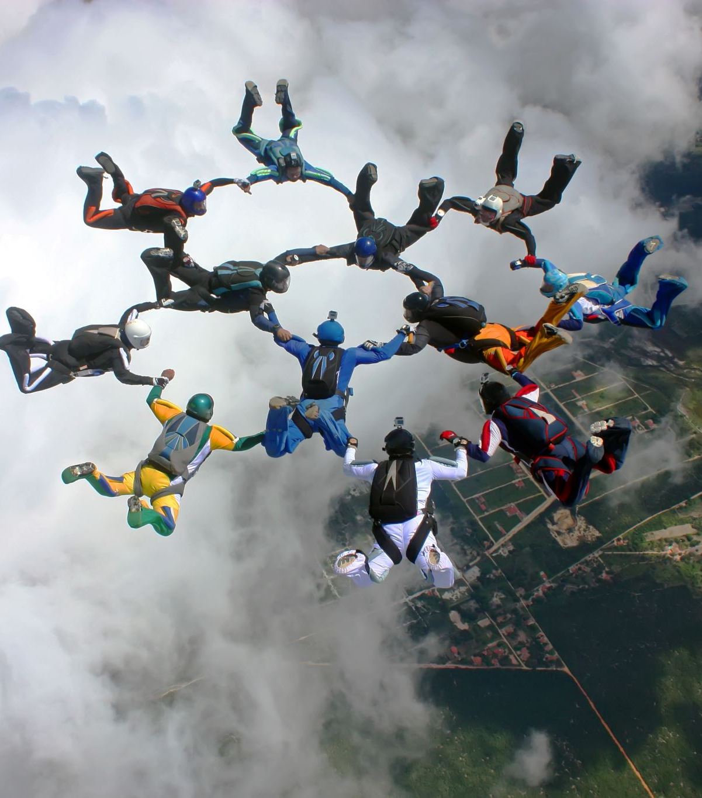
For The People Public Grievance System Shikhar Maheshwari – 16ET415 Kaiwalya Patil – 16ET430

Slide 2

Abstract
People’s feedback is an important aspect of democracy and this often gets overlooked in India. In this project, we aim to get feedback of willing people by making certain online platforms that are open to all. We plan to closely analyse these inputs from the people and extract important parameters, like the problem, location, which department/ministry it is falling under, frequency of submission. This data would be then submitted to the authority of city/state and hence they can be notified about the persisting issues under their locality. Hence by getting such feedbacks, analysing them closely and solving problems, we aim to help people resolve their problems and work as a stepping stone towards perfect democracy

Slide 3
Problem statement
The services which are provided by the government with an assurance “For the People” are built and never looked upon unless there is wreckage in their daily functioning. Since we live in a democracy, it becomes our right to enjoy every service in its best possible way. Hence we aim to solve this problem by creating online platforms immersed with data analytics.

Slide 4
Introduction
The central intuition behind the working of this system is to let people enjoy real democracy. We observed that a lot of recent movements and bills targeted the citizen's privacy or were against the will of citizens.
And lots of influential voices and opinions were left unheard. And this continues and keeps getting deep-rooted with every passing day.
Other than that the genal grievances of the people remain unheard by the intuitions that were established to solved them
The major reason behind all the above being lack of a system that can meaning fully collect, organise and represent to the above mentioned authorities

Slide 5
Literature review
FixMyStreet is a map based website and app by mySociety that helps people in the United Kingdom inform their local authority of problems needing their attention, such as potholes, broken streetlamps, etc.
pro-active citizen feedback was made to fight Dengue and Malarial in Pakistan while also assisting to fight Corruption

Slide 6
Scope and Application
Public Grievance reporting system
Anonymous crime reporting Fasttrack
Quantitively analysis of Individual govt. bodies
Macro Analysis of individual Grievances report to help better allocate budget of Country
Expansion on the E-Governance
Outbreak Prediction

Slide 7
Block Diagram(Overall System)
Social Media Chatbots
Multi platform Application
Platform API Based Bots
User Inputs
Macro Analysis Engine
RESTful API
Classification Parameters
Update
Classification Parameters
NLP Engine
Classified Parameters
Firestore
On web UI
Firestore
Human Classifier
Unclassified Data
Web UI For Institutions(E.g. :- Municipal Corp. , Police)

Slide 8
NLP engine(Flow Chart)
Start
Receive User Inputs
Classify as Verbs , Adjectives , Subject, Time, etc. using
“en_core_web_sm” model form SPACY
Further classify the classified inputs into Disease , Location ,time , Infrastructure problems ,etc. based on classification parameters stored in firestore
Send Classification Parameters from firestore
Update Classification Parameters in firestore
Human Classifier
Classify into department (Institutions)
Save to Firestore DB
Stop

Slide 9
Macro Analysis Engine(Flow Chart)
Start
Send Classified Parameters from Firestore
Pick Key Parameters
Use Random forest Decision trees classifiers to classify disease outbreaks and epidemic
Time vs Report correlation graphs to showcase patters in problems to different institutions(eg:-
Disease reports vs month over the year)
Alert the related institution accordingly In real-time
Stop

Slide 10
E-Governance (Flow Chart)
Start
Scrape active Bills form web
Classify by category
Showcase in mobile App
User Response
Firestore DB
Area representative Web panel
stop

Slide 11
Work Done
Work | Status
NLP engine | ✔
NLP Feedback System | ✔
Web Panels | ✔
Mobile Applications | ✔
Social Media bots | ✔
Macro Analysis Engine | ❌
E-Governance | ✔

Slide 12
Work Done
Work Pending | Weeks
Macro Analysis Engine | 1.5 weeks
Human Classifier | 0.5 weeks

Slide 13

Demonstration Video

Slide 14

References
Fix-my-Street, Brazil
Zubair Bhatti’s work using pro-active citizen feedback
UK’s ‘nudge unit’ used in organ donation

